Slide 1
Team Status Report
Team Argus - 10/7/2014

Slide 2
Overview - Application
Project Direction: Casino Showcase
Need for Security - Chip Count/Money
Use of Landscape - Total Table Interactivity
Game Simplicity - No Custom Game Design

Slide 3
Overview - Requirements
Core Requirements
Two Way Communication
Discrete Code Library
Error Tolerant - Reliable Transfer & Recovery
Serial Access to Device (Diagnostics)
Notes:
WILL REVIEW TOMORROW (10/4) - I felt that these were our most well-defined requirements so far. I’ll look them over tomorrow since we don’t have class. Feel Free to yell at me down here if you think something should be changed/added - BH

Slide 4
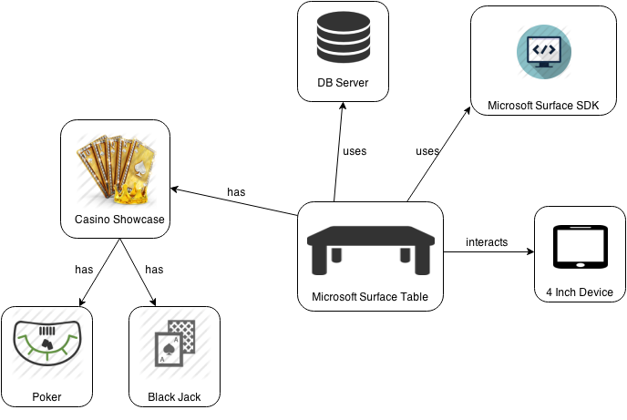
Project Structure

Slide 5
Sub Systems (Use Cases)
<<Surface Table>>
Admin can Add & Withdraw Funds
<<Casino Showcase>>
User can Select, Play, Change & Close Game
<<Black Jack>>
Player can Request Card, Show Hand, Select Bet

Slide 6
Project Plan
Estimations through Project Charter
Cost Analysis (So Far)
Planned Cost = 107 hours
Actual Cost = 75 hours
Earned Value = 70 hours
Variances in scheduled and actual

Slide 7
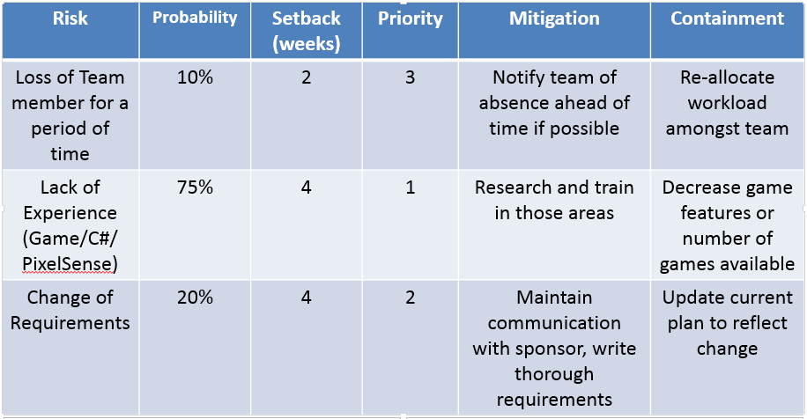
Risk Assesment

Slide 8
What Is Next
-Fine Tune Requirements
-Confirm SRD with Sponsor
-Continue editing first draft of SRD

